Slide 1
Web Service (API) Automation with Performance Testing using Hybrid Framework
Using HTTP Client library in Java
Prasanna Kannan
Guruprasad Bhoovarahamoorthy

Slide 2
Agenda
What is Web Service Testing
Need for Web Service Automation
HTTP Client Library for Rest API’s
Tools used
Hybrid Framework Model for API and Performance Testing
Framework Architecture
Demo
Test Reports(API) and Performance Test Reports
Future Enhancements

Slide 3
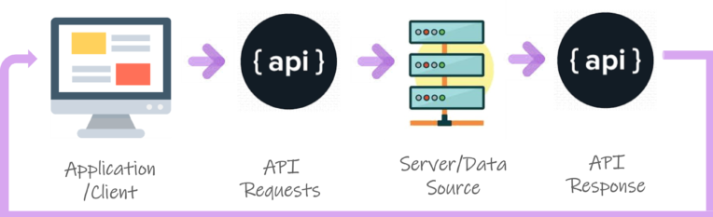
What is Web Service Testing?
Web Services Testing is a type of software testing that validates Web services. The purpose of Web Services Testing is to check the functionality, reliability, performance of the application without the User Interface using API Request and Response
Importance of Web Service Testing
Testing of web services is useful to prevent late detection of errors, which requires complex and costly repairs
Provides access to applications functionality without user Interface
Effective use of time. API testing takes much less time than GUI testing.

Slide 4
What is the need for Web Service Automation?
Data is exchanged via XML and JSON, so any language can be used for automation, independent from the languages used to develop the application​
Different Test Inputs can be used for testing a Particular URL efficiently​
Repeated Testing of the business functionality for different releases​
No specific tools such as Postman, Katalon Studio are required for performing Automation​
Responses of the Web Service can be validated easily​

Slide 5
HTTP Client Library
The HTTP Client library provides a basic API through which HTTP requests can be created and executed from within your model
Http Client can be used to send requests and retrieve their responses
Http Client handles all basic API Protocols such as GET,POST,PUT,DELETE
Responses can be easily validated with some basic JSON libraries
Handles HTTP Requests with authentication

Slide 6





Tools used
Eclipse IDE : Java Programming
Maven : Build tool for Java
Test-NG : Test Validations and Test Reporting
HTTP Client Library : Process HTTP Requests and provides the HTTP Response for Rest API’s
JSON Library : Get String value from JSON Response

Slide 7
Hybrid Framework for API and Performance Testing
Hybrid Framework is a combination of Data Driven and Keyword Driven Framework where the tests are driven with the help of Keywords written in Data files (Excel)
It is easy for any tester to design and execute test code with this framework as this involves minimal coding
Test Data required for the test cases and expected result verification is also handled by this Framework, provided it is given in Master Data File
This framework makes the automated test script easily readable and understandable since it is in the form of Keywords (Similar to Manual Test Steps)
Hybrid Framework allows to run multiple test cases easily by just marking “Yes” against the Test Case Names in Excel
This Framework could be used for any product/application that uses Rest API’s across HBK

Slide 8
Framework Architecture
Master Data File
Framework Components
Master Data File : Excel File containing the List of Test cases along with the Keywords required to run the test cases along with Test Data (URL) and Expected Result
Annotation Transformer
Annotation Transformer : Reads the Data File to identify which test cases are to be executed ( which are marked as “Yes” in Data File)
Test Base
Test Base : Execute the Method(s) which are declared as keywords in Data File
Utilities
API Methods
API Methods : Process the Get/Post/Put/Delete requests(URL) using HTTP Client Library and returns the Responses
Utilities : Reads the Data File for Expected response value from HTTP Response for comparison
Test Cases and Reports
API Test reports (Test-NG)
Test Cases and Reports : Contains Validation Test Steps for Comparing Actual and Expected Results. As a result of execution , two reports are generated one for API Tests (Test-NG) and other for Response Time (Excel Report)
Test Cases
Performance Test Reports

Slide 9
Master Data File

Slide 10
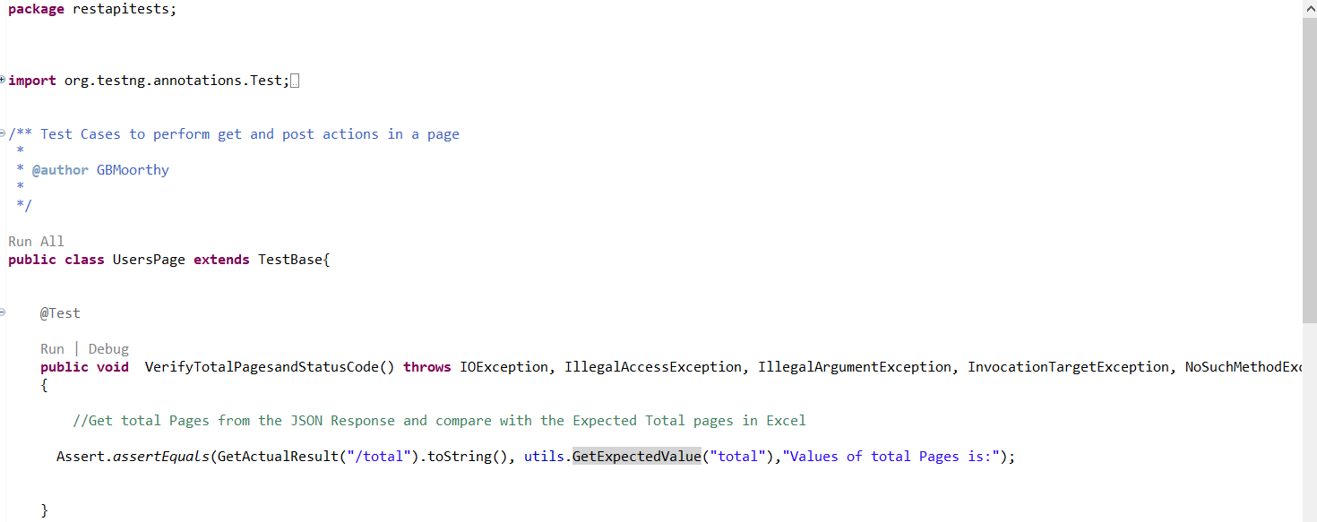
Test Cases
Test Case Code designed using this Framework will look as simple as shown below

Slide 11
Demonstration

Slide 12
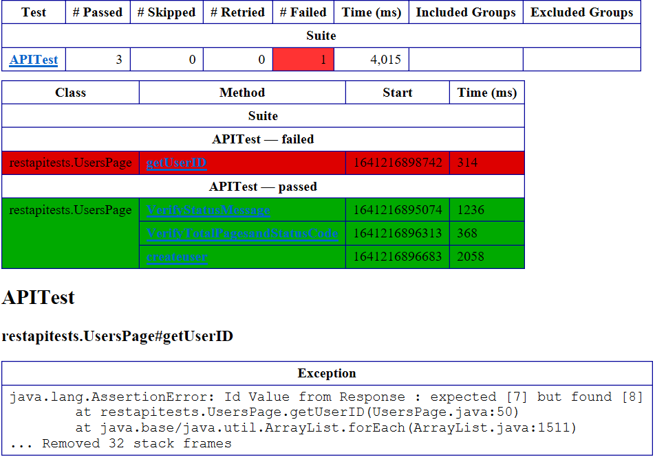
Test Reports
Default Test Reports are generated by Test-NG in html format.

Slide 13
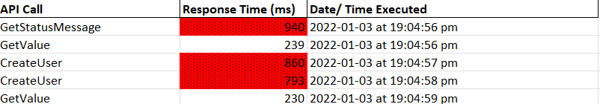
Performance Test Report
For each HTTP Requests , Response Time ( Performance of the Web Service) is calculated by the Framework and saved in Separate Data File.

Slide 14
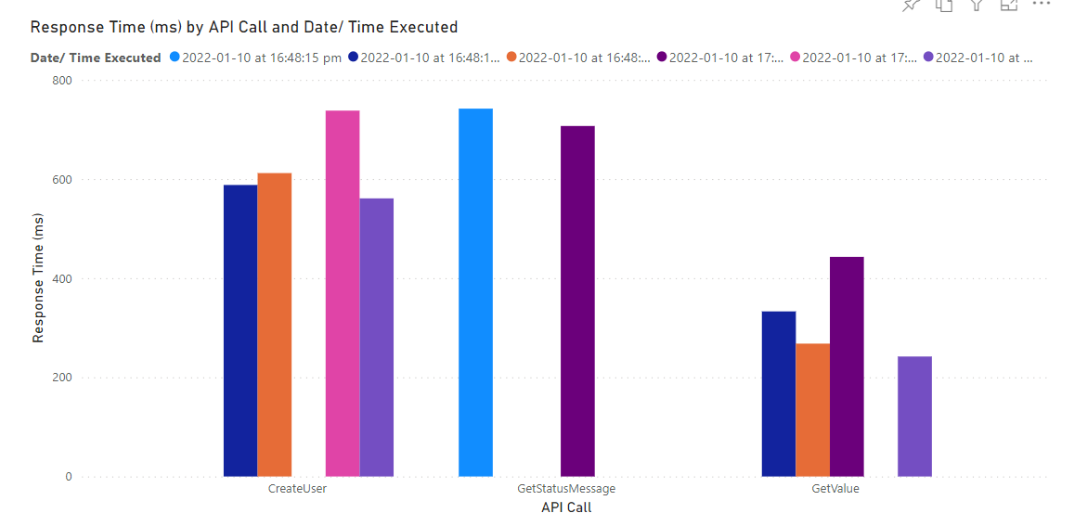
Performance Test Report (continued..)

Slide 15
Future Enhancements
Custom Test Reports : Current Framework has default Test-NG Reports . Reports can be customized as per the Requirement
Feasibility check to Accommodate load Testing in the current Framework
Schedule the Tests in any CI/CD tools such as Jenkins/ Azure Devops

